Slide 1
TELECOM BILLING SYSTEM
C. Poojitha [23BFA33L05]
C. Mounika Roy [22BFA33147]

Slide 2
agenda
Creating basic Telecom Billing System, you can perform and manage billing operations like they do in Telecom companies. Here, you can add records with name, phone number and the amount of payment. You can view, modify, search and delete existing records.

Slide 3
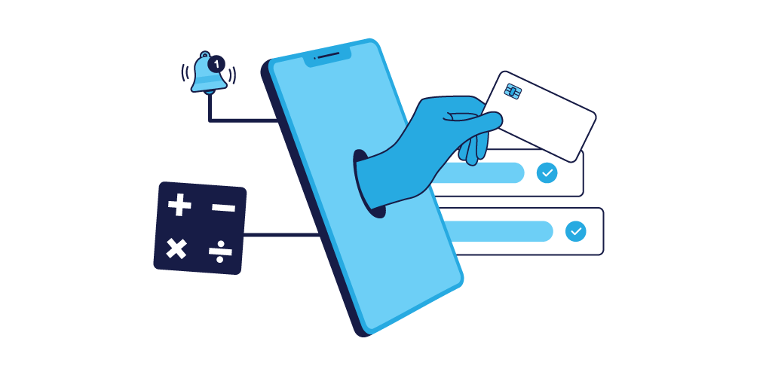
what is telecom billing system : A telecom billing software refers to system that is developed for keeping track of all telephone, data, and internet charges as well as payments. These billing system programs are often installed by Internet Service Providers (ISPs) and phone companies.

Slide 4
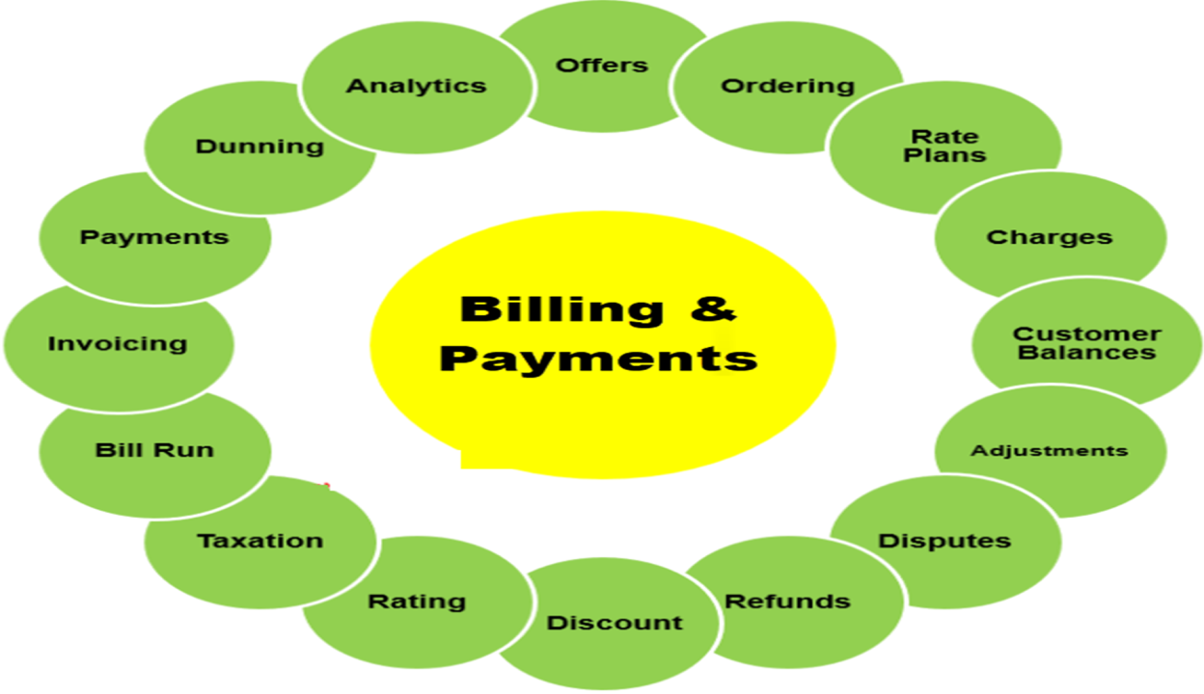
How does telecom billing work:
The telecom billing software allows companies to pay as they go instead of having to pay a flat monthly fee for their telecom services. This is especially popular among consumers with multiple phone lines or high cell phone usage. Payment can be automatically collected by deducting funds from bank accounts, credit cards, or other payment methods users have integrated into their accounts.

Slide 5
Overview :
How can C programming be used to implement a telecom billing system? C programming can be used to handle the core logic of telecom billing systems, including data handling, charge calculations, memory management, and file handling. C is a powerful language that allows for efficient data processing, which is essential for telecom billing systems that handle large amounts of usage data.
What data structures are typically used in a telecom billing system implemented in C? Structures are commonly used to store customer information (e.g., ID, name, balance) and service usage details (e.g., number of minutes used, data consumed). Arrays and linked lists may also be used to manage large volumes of customer data.

Slide 6
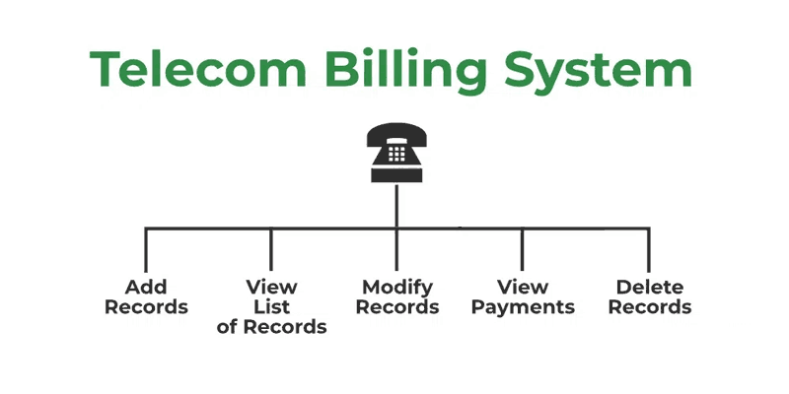
Operations :
The following are the operations and functionalities offered by the telecom billing system.
Add New Record: Add new customer record.
View List of Records: View all the records at a glance.
Modify Record: Modification of an already existing record.
View Payment: View the bill for a given customer.
Delete Records: The deletion of a record from the memory

Slide 7
Components & Program : Components of the telecom billing system: The Telecom Billing System is divided into multiple components each performing a specific task. Necessary libraries we will use the following libraries: 1.<stdio.h>: for input and output 2.<string.h>: for string manipulation both of these are standard libraries that come bundled with the c compiler. DATA STRUCTURE TO HOLD CUSTOMER INFORMATION A structured Customer is defined as holding information about a customer. Array customers [100] of type Customer is created to store customer records. It can hold up to 100 records. customerCount is an integer variable used to keep track of the number of customers.

Slide 8

CODE FOR DATA STRUCTURE TO HOLD ACCOUNT INFORMATION :- // structure to hold customer information struct customer { char name[50]; char phonenumber[15]; float usage; float totalbill; }; // global array to store customer data struct customer customers [100]; // global variable to keep track of the number of customers int customercount = 0;

Slide 9
AddRecord():
The addRecord () is created in order to add a customer record in the memory.
The function promotes user to enter the User Id, Name, phone number, Total bill usage.
// Function to add a new user
void addUser(struct User users[], int *userCount) {
printf("Enter User ID: ");
scanf("%d", &users[*userCount].userId);
getchar(); // To consume the newline character
printf("Enter Name: ");
fgets(users[*userCount].name, sizeof(users[*userCount].name), stdin);
users[*userCount].name[strcspn(users[*userCount].name, "\n")] = '\0'; // Remove newline character
printf("Enter Phone Number: ");
fgets(users[*userCount].phoneNumber, sizeof(users[*userCount].phoneNumber), stdin);
users[*userCount].phoneNumber[strcspn(users[*userCount].phoneNumber, "\n")] = '\0'; // Remove newline character
users[*userCount].totalBill = 0.0;
(*userCount)++;
printf("User added successfully.\n");
}

Slide 10
CallRecord :- A CallRecord in telecom billing system is a data entry that stores details about a call made by a customer this records essential for tracking call usage, calculating bills and maintaining customer history // Function to add a call record void addCall(struct Call calls[], int *callCount, int userId) { printf("Enter call duration (in minutes): "); float duration; scanf("%f", &duration); float cost = calculateCallCost(duration); calls[*callCount].userId = userId; calls[*callCount].duration = duration; calls[*callCount].cost = cost; (*callCount)++; printf("Call added successfully.\n"); }

Slide 11
Generate bill :- The bill generation process in a telecom billing system is responsible for calculating the total charge for a customer based on their call records.
// Function to generate and display a bill for a user
void generateBill(struct User users[], int userCount, struct Call calls[], int callCount, int userId) {
float totalBill = 0.0;
// Calculate total bill by summing the cost of calls made by the user
for (int i = 0; i < callCount; i++) {
if (calls[i].userId == userId) {
totalBill += calls[i].cost;
}
}

Slide 12
Display the information :-
Displaying information is essential for managing customers tracking call usage and generating accurate bills. the systems provides various records to help users and telecom providers to monitor data efficiently.
// Display user information and the bill
printf("\nBill for User ID: %d\n", userId);
for (int i = 0; i < userCount; i++) {
if (users[i].userId == userId) {
printf("Name: %s\n", users[i].name);
printf("Phone Number: %s\n", users[i].phoneNumber);
printf("Total Bill: $%.2f\n", totalBill);
break;
}
}
}

Slide 13
Main function
The main function handles the primary control of the program
An infinity while loop is used to provide the user with a dashboard that resets after each
A switch case is used to process the users choice
// Main function to run the program
int main() {
struct User users[100]; // Array to store users
struct Call calls[500]; // Array to store call records
int userCount = 0, callCount = 0;
int choice, userId;
while (1) {
printf("\nTelecommunication Billing System\n");
printf("1. Add User\n");
printf("2. Add Call Record\n");
printf("3. Generate Bill\n");
printf("4. Display All Users\n");
printf("5. Exit\n");
printf("Enter your choice: ");
scanf("%d", &choice);

Slide 14
switch (choice) {
case 1:
addUser(users, &userCount);
break;
case 2:
printf("Enter User ID to record the call: ");
scanf("%d", &userId);
addCall(calls, &callCount, userId);
break;
case 3:
printf("Enter User ID to generate bill: ");
scanf("%d", &userId);
generateBill(users, userCount, calls, callCount, userId);
break;
case 4:
displayUsers(users, userCount);
break;
case 5:
printf("Exiting the program.\n");
exit(0);
default:
printf("Invalid choice. Please try again.\n");
}
}
return 0;
}

Slide 15
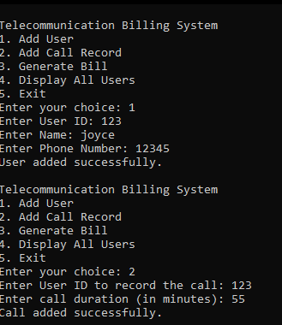
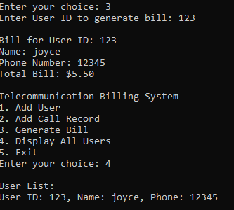
Output of the program :-

Slide 16
Thank you

